Slide 1
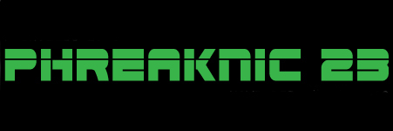
Hacking Time
My Journey into Getting the Most Out of Every Minute
Marc Brosey

Slide 2
Marc Brosey
mdbrosey@gmail.com
@marcbrosey
Entreos
www.entreos.com

Slide 3
It All Started With a Forbes Article
It claimed – Billionaires have their schedules timed down to five minute increments.
I looked for this article from years ago, but could not find it.
I thought it might be cool to be a billionaire, so I built a spreadsheet to track my time.

Slide 4
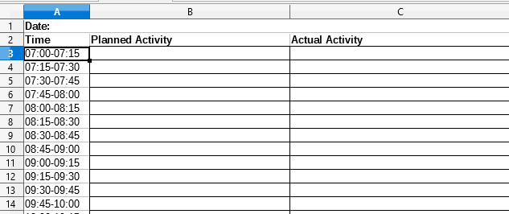
Time Tracking Sheet

Slide 5
Time Tracking Sheet
Tracking 15 minutes is much easier than 5.
I noticed that what I planned to do often was trumped by what I actually, urgently needed to do.
I started to notice some patterns on how my time was spent, and wasted.
Analyzing my time this way was cumbersome.

Slide 6
Along Came Jira
My workplace was a wild west for the first year I worked there.
Then they actually created a project management team and mandated we use a little tool called, Jira.

Slide 7
Jira
In Jira you can create simple tasks.
You can place those tasks into a sprint.
And then as you work on those tasks you can move them across a Kanban board.
Moving a task across a Kanban board produced happy chemicals inside my brain.

Slide 8
Jira
As far as I was concerned, Jira was the bee’s knees… except for the price tag.
$120 per year for a cloud instance.
Only $10 for a local server, but very little support to get up and running and keep it that way.

Slide 9
All I Wanted Was a Kanban Board
I just needed a tool to keep track of tasks that I needed to complete…
And…
A way to release all those happy chemicals to keep me motivated to work on the next task.

Slide 10
Open Source Solutions?
Not really well supported.
Kanban board was an afterthought and often had to be added using a mod.
The adoption of PHP 7 left a large number of good open source project management applications written in PHP 5 defunct.

Slide 11
Ext4 Filesystem to the Rescue?
Turns out a simple file system – file/directory database – can be used to track tasks.
Using a common file explorer, a poor man’s Kanban board can be created.
I setup a Raspberry Pi running Raspian as my task tracking server and created bash scripts to run where needed.

Slide 12
What Happened to Time Tracking?
It seems like we got off on a project management tangent.
While all of these project management solutions help you track your tasks, the things you need to get done, none of them adequately track your time, the limited resource required to get those tasks done.

Slide 13
But You Can Track Time in Jira!
Every project manager I have ever had has asked me to track my time in their project management software.
They ask me to estimate the time it will take me to complete the task.
Then they tell me I’m full of it and reduce that time estimate.
Then they ask me to track the real time it took me for completion of the task.
Then they get upset that the real time to completion is longer than their estimate.

Slide 14
The Agency
When working for a web agency, they wanted me to track every minute of every project for every client I was working on.
I was encouraged to use Freshbooks and Toggle to accomplish this.

Slide 15
Freshbooks and Toggle
When you’re doing web development at a web agency, you have to have a lot of browser tabs open.
Freshbooks and Toggle both require that they be another browser tab.
Google Chrome likes to eat a ton of memory.

Slide 16
Samsung Clock App
The Samsung Clock App on my phone has an excellent stopwatch on it.
With one tap I can “lap” the time to keep track of each task I’m working on throughout the day.
With my cellphone stopwatch and a composition notebook, I started timing everything.

Slide 17
Red Book of Time
My time book was good for compiling a timesheet for my work at the web agency.
It also had its uses for figuring out exactly how much time I was spending doing routine daily actions.
It was, however, a complete waste of time for making projections or making scheduling changes easily based on the aggregate of what I had written down.
Being raw data collected in a notebook, it cannot be easily parsed and analyzed.

Slide 18
Panic Attack
During this time I started suffering from extreme anxiety (panic attacks, insomnia, the works).
I found out through my time book that 12 hours a week at the gym was the level at which I could actually eliminate most of my anxiety symptoms.
Somehow I needed to consistently squeeze this 12 hours a week into my schedule.

Slide 19
Time Tracking Application
I decided to build my own time tracking application to solve my two primary time tracking problems.
One – How can I not spend too much time on one task to the exclusion of other important ones?
Two – How can I distribute enough time on everything that I want to focus on during my week?

Slide 20
Problem Set
I had a simple backlog that all of my tasks were dumped into.
My philosophy was that if I could just get busy, I could get everything done eventually.
It was too easy to choose easy or routine tasks from the backlog.
The more I would do a routine task, the more I would choose to do a similar task.
For example, after completing a cleaning task I would have cleaning on my mind so I would be more likely to choose another cleaning task to work on next.

Slide 21
Focus Categories
Cleaning
Development
Exercise
Learning
Organization
Publish/Deploy
Relationships
Spirituality
Sleep

Slide 22
The Time Management Plan
Spend one hour per day in each category when possible for a total of six hours per week per category.
Get eight hours of sleep per night.
Play catch-up wherever necessary.
Attempt to reach a total time working on active tasks of 60 hours per week.

Slide 23
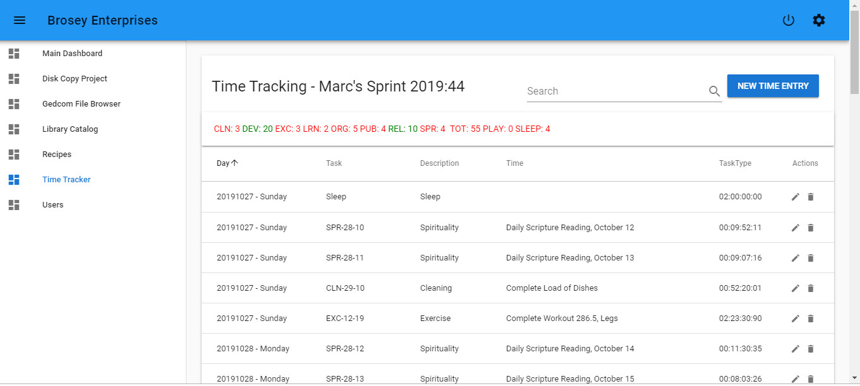
Time Tracker

Slide 24
Time Tracker
https://github.com/thebunnynetwork/timetracker
Vagrant file provided, just type vagrant up.
Default user credentials…
user: admin pass: timetracker
I’ve got this application running on a Raspberry Pi on my home network. It’s really only set up with security to run on a private home network. Add your own TLS cert. if you want it.

Slide 25
Time Tracker Problem
Using the dashboard on my Time Tracker program, I was able to balance my week across all of my focus areas.
This was good-ish, but I found myself making frustratingly slow progress on projects in each focus area.
For organization I have set up a home Library Catalog for the 1,500 books we have collected. Working on it for one hour per day, only six hours per week means three months later I’m still not done.

Slide 26
Two Good Books
As part of my learning category I read two helpful books.
Essentialism: The Disciplined Pursuit of Less by Greg McKeown
How to Fail at Almost Everything and Still Win Big by Scott Adams

Slide 27
Helpful Takeaways
Greg McKeown bills Essentialism as a book for those who feel like they are just moving an inch in every direction at once but not really going anywhere.
That was me. A Jack at focusing a little on all of the things but a master of fully accomplishing none of the things.
It is from this book that I came up with a new method of task prioritization.

Slide 28
The Daily Essentials Card
I keep a task book filled with my current backlog.
Each day I write out a list of eight tasks that I feel are essential for me to complete soon, maybe even that day.
I leave space for two additional urgent tasks if I forgot something that I need to squeeze in or when the unexpected pops up.
But after those slots are filled, my day is locked down and only those essentials are my focus.

Slide 29
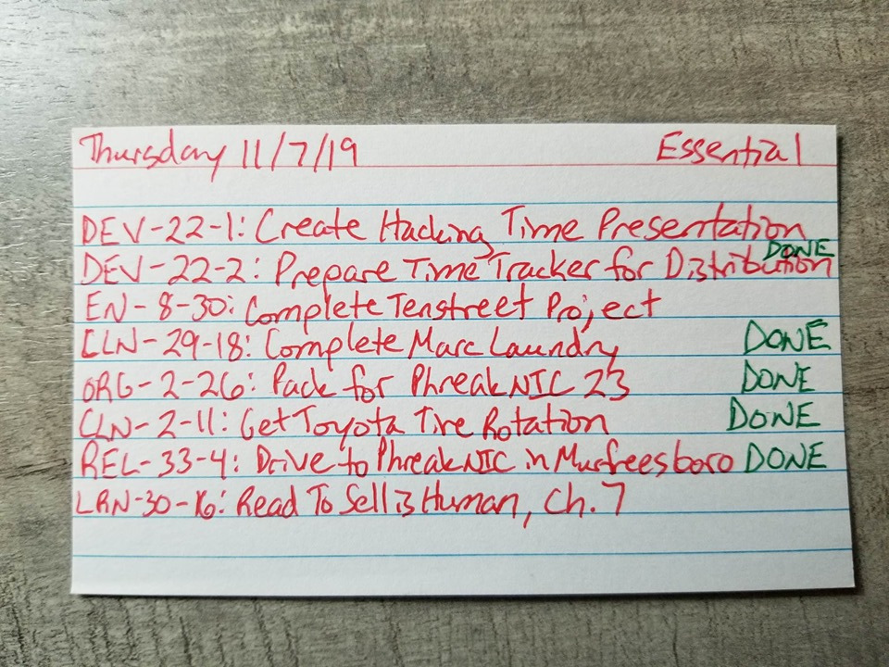
Daily Essentials

Slide 30
Helpful Takeaways
In the book Essentialism, McKeown also emphasizes the importance of daily play in building mental connections and brain plasticity.
This is why I have added PLAY as its own category to my time tracker dashboard. It turns green like everything else when one hour is devoted to it each day.

Slide 31
Helpful Takeaways
In How to Fail at Almost Everything and Still Win Big, Scott Adams’ premise is that we are moist, biological computers that can be programmed.
He talks about how he focused his mind by use of affirmations. Specifically, “I, Scott Adams, will be a famous cartoonist.”

Slide 32
Affirmations
Scott Adams is not the first author to recommend affirmations that I have read.
Affirmations can be verbalized, written down, or simply read. I’ve found it helpful to do all three at the same time.
Affirmations are best absorbed just before going to sleep.

Slide 33
Affirmations
Those who effectively use affirmations, Scott Adams included, make it clear it’s not magic, but programming.
Before I go to bed each night I take a piece of notebook paper and make a list of all the positive things I can think of that happened that day. I then write my affirmations, the good things I want to focus on and want to be. Then I sleep on all the good things.

Slide 34
Affirmations
This is way more effective than sleeping on default thoughts from a blah day, or worse, negative thoughts that creep up inside my head.
Affirmations and listing out the positives from each day are probably the best gift I give to my future self.

Slide 35
Time or Energy?
Scott Adams also believes that time management is not as important as energy management.
Some tasks are easier to do in the morning, others right after lunch. The more efficiently tasks are approached, the more things can be done in less time, and with less energy.
His advice is to optimize the amount of energy you have whenever possible.

Slide 36
What’s Next?
So, now that I’ve been doing all of this time and project tracking and affirmations, am I a billionaire yet?
Nope.
Not yet.

Slide 37
Falling off the Wagon
I’ve experienced how easy it is to fall off the wagon.
When I fall off the wagon, the sooner I can get back on, the better I will be.

Slide 38
Practical Next Steps
Implement Task Book and Daily Essential Cards into Time Tracking program.
Add graphs to Time Tracker to analyze time spent across categories and projects.
Make application a progressive web application so it can be accessed using a phone while away from the network it’s being served on.
Make application voice responsive so it can be used when one is unable to type.

Slide 39
I’m Not a Millionaire
But I am way more organized and responsible than I used to be.
I feel like I am getting more done now, more consistently than I ever have. I cannot conclusively say that is the case, but I can say that the data I now have points to me being a more highly productive person as there was no productive data before such data was collected.

Slide 40
Questions, Comments?
Marc Brosey
mdbrosey@gmail.com
Entreos
We’re building a web native operating system.
www.entreos.com
github.com/thebunnynetwork/timetracker

